Slide 1

Welcome to
Our Sunday School
We’ll start at 9:07
visit OurSundaySchool.com for more about our class

Slide 2
Ephesians, week 3 (pages 17–23)

Slide 3

Visitors: loan you
a copy for today
Members: get a
print edition
Online: visit OurSundaySchool.com

Slide 4
The big picture
Ephesians 1–3: who(se) we are
Ephesians 4–6: what we do as a result

Slide 5
Hear: Ephesians 1

Slide 6
Ephesians 1:1a
Paul, an apostle of Christ Jesus by the will of God,

Slide 7
Cross references in the LSB (letters)
2Co 1:1
Ro 8:1
1Co 1:1
Ac 9:13
Ac 18:19
Col 1:2

Slide 8
Footnotes in the LSB (numbers)
Lit through
Or holy ones
Three early mss omit at Ephesus

Slide 9
Excursus: Bible translations

Slide 10

From IconicAuctions.com

Slide 11
Excursus: Bible translations
Autographs (one per book)

Slide 12


Slide 13
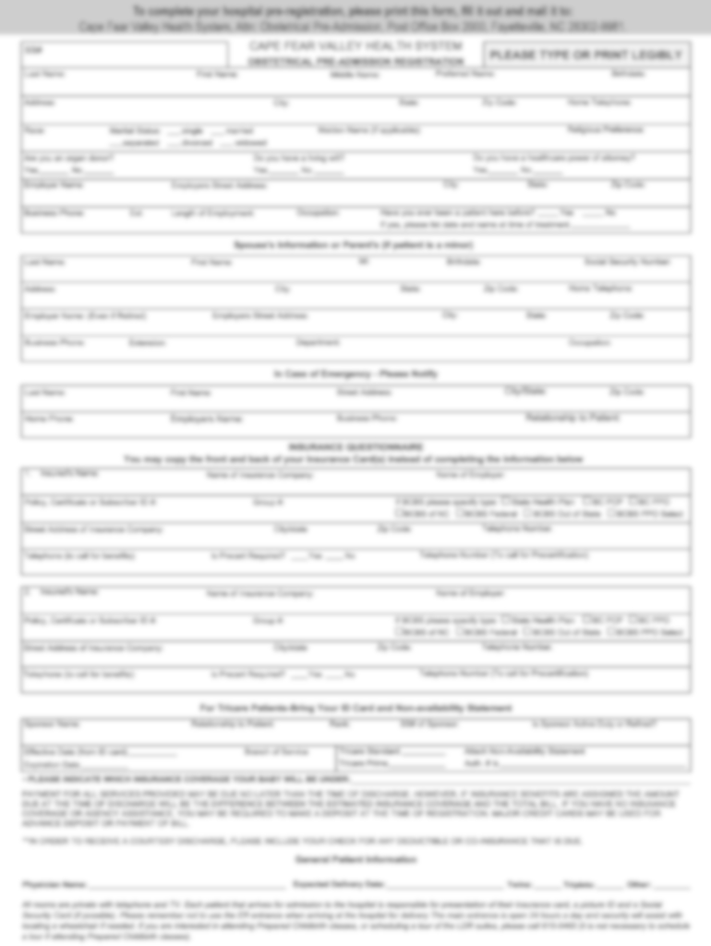

Slide 14
Excursus: Bible translations
Autographs (one per book)
Copies (many per book)

Slide 15
An example
Let’s eat, Grandma!
Let’s eat Grandma!

Slide 16
Excursus: Bible translations
Autographs (one per book)
Copies (many per book)
Variants (copy errors—intentional or not)

Slide 17
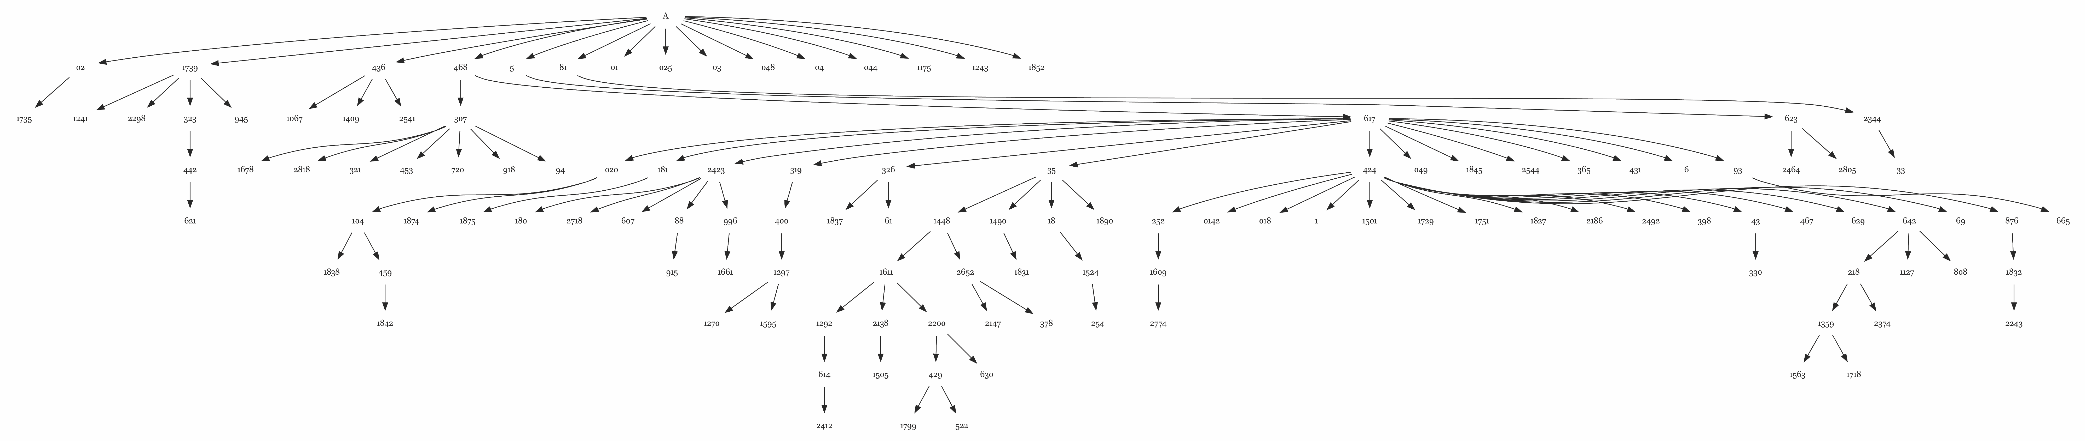
The predominant textual flow diagram for non-fragmentary witnesses in the Catholic Epistles; image source: Peter J. Gurry, A Critical Examination of the Coherence-Based Genealogical Method in New Testament Textual Criticism (Brill, 2017), pp. 60-61

Slide 18
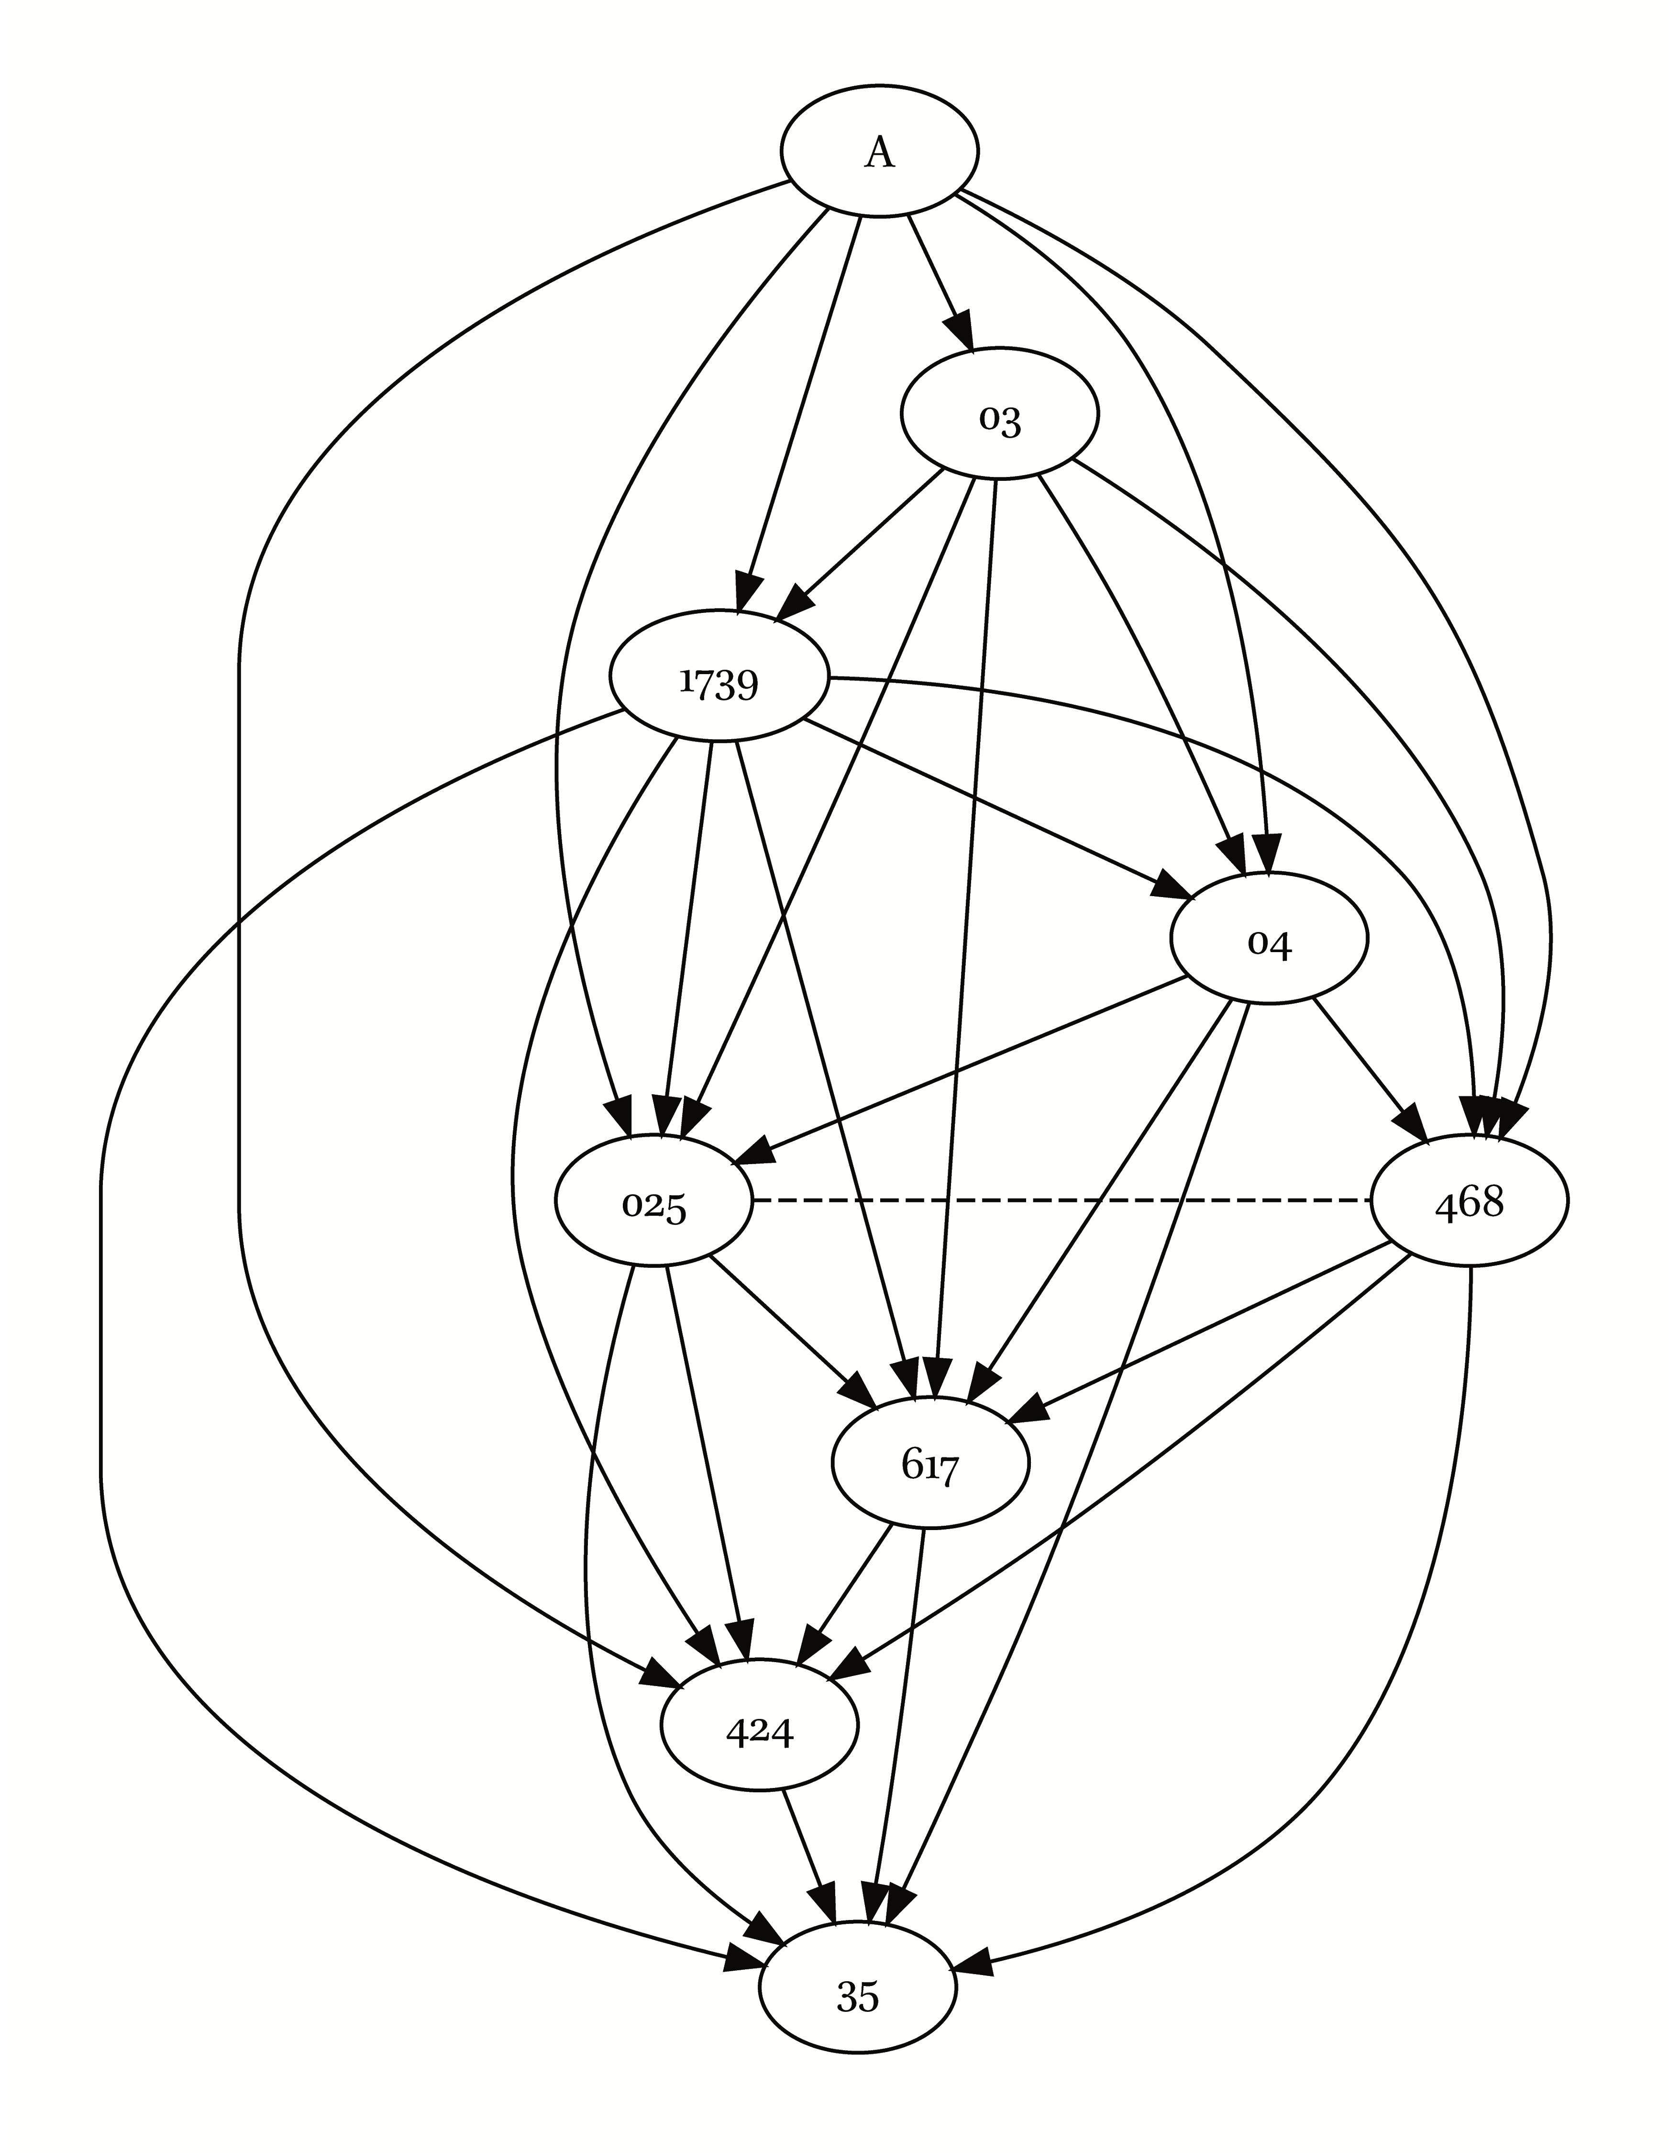
Peter J. Gurry, A Critical Examination of the Coherence-Based Genealogical Method in New Testament Textual Criticism (Brill, 2017)

Slide 19
The predominant textual flow diagram for non-fragmentary witnesses in the Catholic Epistles; image source: Peter J. Gurry, A Critical Examination of the Coherence-Based Genealogical Method in New Testament Textual Criticism (Brill, 2017), pp. 60-61

Slide 20
Excursus: Bible translations
Autographs (one per book)
Copies (many per book)
Variants (copy errors—intentional or not)
Families (communities of error)

Slide 21
Major Greek New Testament families
Western (Syrian) | Byzantine | Alexandrian
From north Africa to Italy; Gaul to Syria | From Constantinople; Byzantine Empire | From Alexandria
3rd – 9th centuries | 5th – 16th centuries | 2nd – 4th centuries
Western Church | Eastern Church; Textus Receptus | Codex Vaticanus, Codex Sinaiticus
Pre-1520 | 1520-1900 | 1900→
From Wikipedia’s article on Textual Criticism

Slide 22
Excursus: Bible translations
Autographs (one per book)
Copies (many per book)
Variants (copy errors—intentional or not)
Families (communities of error)
Textual criticism (identifying autographs)

Slide 23
Textual criticism recommended reading
Wikipedia’s article on textual criticism

Slide 24
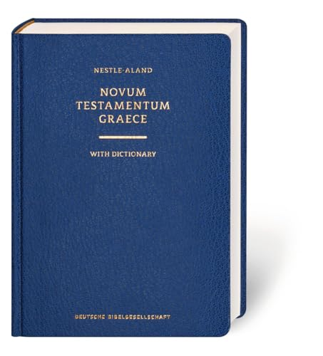

Slide 25
Excursus: Bible translations
Autographs (one per book)
Copies (many per book)
Variants (copy errors—intentional or not)
Families (communities of error)
Textual criticism (identifying autographs)
Critical edition (closest to the autograph)

Slide 26
Excursus: Bible translations
Autographs (one per book)
Copies (many per book)
Variants (copy errors—intentional or not)
Families (communities of error)
Textual criticism (identifying autographs)
Critical edition (closest to the autograph)
Modern translations (picking a family-ish)

Slide 27
Major Greek New Testament families
Western (Syrian) | Byzantine | Alexandrian
From north Africa to Italy; Gaul to Syria | From Constantinople; Byzantine Empire | From Alexandria
3rd – 9th centuries | 5th – 16th centuries | 2nd – 4th centuries
Western Church | Eastern Church; Textus Receptus | Codex Vaticanus, Codex Sinaiticus
Pre-1520 | 1520-1900 | 1900→
Wycliffe, Douay-Rheims (original) | KJV, NKJV, Tyndale, Coverdale, Geneva | NIV, ESV, CSB, NASB, LSB
From Wikipedia’s article on Textual Criticism

Slide 28
Footnotes in the LSB (numbers)
Lit through
Or holy ones
Three early mss omit at Ephesus

Slide 29
Ephesians 1:1–2 (NA28)
Παῦλος ἀπόστολος Χριστοῦ Ἰησοῦ διὰ θελήματος θεοῦ τοῖς ἁγίοις τοῖς οὖσιν
[ἐν Ἐφέσῳ] καὶ πιστοῖς ἐν Χριστῷ Ἰησοῦ, χάρις ὑμῖν καὶ εἰρήνη ἀπὸ θεοῦ πατρὸς ἡμῶν καὶ κυρίου Ἰησοῦ Χριστοῦ.

Slide 30
Ephesians 1:1–2 (NA28)
Παῦλος ἀπόστολος Χριστοῦ Ἰησοῦ διὰ θελήματος θεοῦ τοῖς ἁγίοις τοῖς οὖσιν
[ἐν Ἐφέσῳ] καὶ πιστοῖς ἐν Χριστῷ Ἰησοῦ, χάρις ὑμῖν καὶ εἰρήνη ἀπὸ θεοῦ πατρὸς ἡμῶν καὶ κυρίου Ἰησοῦ Χριστοῦ.

Slide 31
What’s new in this handout
Christian Standard Bible (CSB) →
Legacy Standard Bible (LSB)
Added reflection/journal and
quotes from commentary pages (p. 83)
[Variants]

Slide 34
“in Ephesus” options
“in Ephesus” present
“in Ephesus” not present

Slide 35
“in Ephesus” options
“in Ephesus” present
“in Ephesus” not present
  Empty space with bad grammar; Origen (3rd), Basil (4th)
  Other city (Marcion(1st/2^{nd)}: Laodicea)

Slide 36
“in Ephesus” bigger points
It was written to believers
Transparency matters

Slide 37
Ephesians, week 3 (pages 17–23)

Slide 38
Ephesians 1:1a
Paul, an apostle of Christ Jesus by the will of God,

Slide 39
The nouns (and one verb)
Christ (46)
God (31)
Lord (26)
Jesus (20)
Spirit (14)
Grace (12)
Father (11)
Love (10/10)
Human (9)
Wife (9)
Church (9)
Flesh (9)
Body (9)
Glory (8)
Peace (8)
Faith (8)
World (7)
Husband (7)
Desire (7)
Truth (6)
Heart (6)
Mystery (6)
Power (5)
Gentiles (5)
Wealth (5)
Child (5)
Light (5)

Slide 40
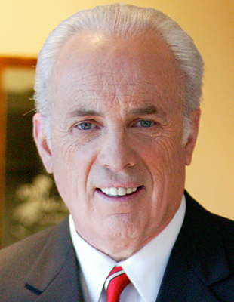
Dr. John MacArthur
In his salutation, Paul presents the dual source of his apostolic authority, a dual description of believers, a dual blessing for believers, and the dual source of those blessings

Slide 41
Ephesians 1:1a
Paul, an apostle of Christ Jesus by the will of God,
To the saints who are at Ephesus and who are faithful in Christ Jesus: Grace to you and peace from God our Father and the Lord Jesus Christ.

Slide 42
Ephesians, week 3 (pages 17–23)

Slide 43
Normal first-century introduction: author, recipient, greetings
Example: Paul, Ephesians, rejoice!

Slide 44

The Spruce / Diana Chistruga

Slide 45
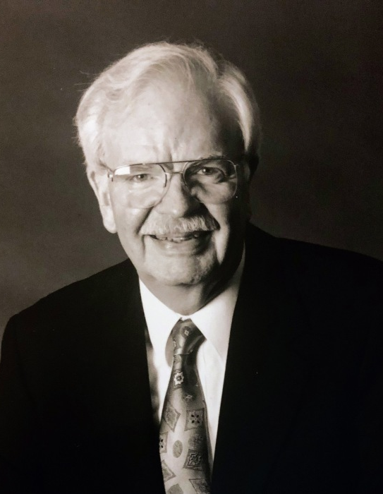
Dr. Walter Liefeld
Ancient letters opened with kind words of greeting. Christian letters “baptized” such commonalties, using such ordinary words as peace and grace with a Christian meaning.

Slide 46
Ephesians, week 3 (pages 17–23)

Slide 47

Dr. Tony Merida
Before his conversion Paul was breathing murderous threats against Christians, yet he went on to write 13 letters in the New Testament….

Slide 48
Dr. Tony Merida
Paul’s life reminds us that God can radically change anyone. Here we have a man who might formerly have been compared to a terrorist now writing the New Testament.

Slide 49
Ephesians, week 3 (pages 17–23)

Slide 50
Apostles in the New Testament
The 12 (Matthew 10:2)
Matthias (Acts 1:26)
Paul and Barnabas (Acts 14:14)
Apollos (1 Corinthians 4:6–9)
James, half-brother of Jesus (Galatians 1:19)
Epaphroditus (Philippians 2:25)
Silas and Timothy (1 Thessalonians 1:1; 2:5–6)
Jesus Christ (Hebrews 3:1)

Slide 51
Ephesians, week 3 (pages 17–23)

Slide 52

Dr. Bryan Chapell
This means not only that Paul belongs to Christ Jesus, but also that Paul represents him so definitely that Paul’s message is Christ’s own message

Slide 53
Ephesians, week 3 (pages 17–23)

Slide 54
Dr. Bryan Chapell
Paul says that he is an apostle of Christ Jesus by “the will of God” (v. 1b). Against the great challenges that he is facing, this phrase is his defense, his offense, and his confidence.

Slide 55
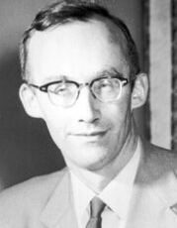
Dr. Markus Barth
This epistle contains more references to the will or decision of God than any other NT book, except the Gospel of John

Slide 56
Commentaries
Quotes are due to Jim by Thursday night
If you would like one, let Jim know

Slide 57
Prayer time
Write down your prayer requests (on the Weekly Update or in the comments)
Lean in, engage, and pray for someone not with you
Be out of this room by 9:50
Go worship

